Slide 1
How do you decide when prone positioning is not working?

Slide 2
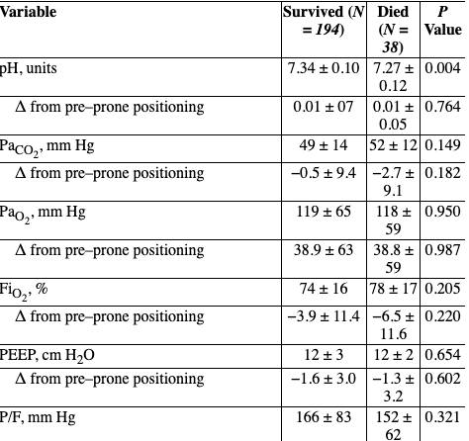
Do blood gasses predict response?
https://www.atsjournals.org/doi/10.1164/rccm.201311-2056LE
Re-analysis of PROSEVA: paired blood gasses
No association between O2 or PaCO2 response
“We conclude that the increase in survival seen in patients with ARDS who receive prone ventilation does not depend on whether the change in position improves gas exchange and infer that it results from the ability of prone positioning to reduce VILI.”

Slide 3
Deadspace fraction?
Gattinoni et al. [35] showed that subjects who had evidence of a decreased VDphys in the prone position based on a decrease in PaCO2 had lower mortality (mortality at day 28 was 35.1 % versus 52.2 %, relative risk = 1.48 with confidence intervals 1.07–2.05, p = 0.01)
Gattinoni L, Vagginelli F, Carlesso E, Taccone P, Conte V, Chiumello D, et al. Decrease in PaCO2 with prone position is predictive of improved outcome in acute respiratory distress syndrome. Crit Care Med. 2003;31(12):2727–33.

Slide 4
Perhaps driving pressure change is better? MARS study
https://erj.ersjournals.com/content/52/suppl_62/PA327.abstract

Slide 5
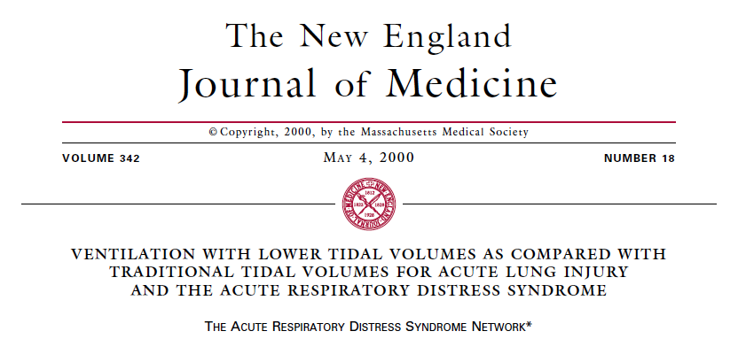
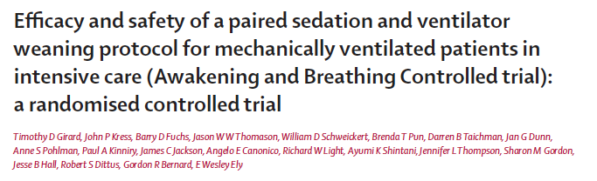
Who cares? Just do what the trials did
Sometimes conflicting goals
Notes:
Today, modern intensive care medicine concepts aim at early reduction of the level of sedation (1) to promote spontaneous breathing efforts (2,3) and early mobilization (4), in order to avoid negative effects of deep and prolonged sedation and (respiratory) muscle weakness (5). Epidemiological data suggest an increase in the use of partial ventilator support modes (6).
In volume-preset AC, such breath stacking asynchrony may not only cause discomfort for the patient, but can result in uncontrolled delivery of tidal volumes (V_{T}) that are up to twice as high as intended (7).
1. Kress JP, Pohlman AS, O'Connor MF, et al. Daily interruption of sedative infusions in critically ill patients undergoing mechanical ventilation. N Engl J Med 2000;342:1471-7. 10.1056/NEJM200005183422002 [PubMed] [CrossRef] [Google Scholar]
2. Ely EW, Baker AM, Dunagan DP, et al. Effect on the duration of mechanical ventilation of identifying patients capable of breathing spontaneously. N Engl J Med 1996;335:1864-9. 10.1056/NEJM199612193352502 [PubMed] [CrossRef] [Google Scholar]
3. Girard TD, Kress JP, Fuchs BD, et al. Efficacy and safety of a paired sedation and ventilator weaning protocol for mechanically ventilated patients in intensive care (Awakening and Breathing Controlled trial): a randomised controlled trial. Lancet 2008;371:126-34. 10.1016/S0140-6736(08)60105-1 [PubMed] [CrossRef] [Google Scholar]
4. Schweickert WD, Pohlman MC, Pohlman AS, et al. Early physical and occupational therapy in mechanically ventilated, critically ill patients: a randomised controlled trial. Lancet 2009;373:1874-82. 10.1016/S0140-6736(09)60658-9 [PubMed] [CrossRef] [Google Scholar]
5. Jaber S, Petrof BJ, Jung B, et al. Rapidly progressive diaphragmatic weakness and injury during mechanical ventilation in humans. Am J Respir Crit Care Med 2011;183:364-71. 10.1164/rccm.201004-0670OC [PubMed] [CrossRef] [Google Scholar]
6. Esteban A, Frutos-Vivar F, Muriel A, et al. Evolution of mortality over time in patients receiving mechanical ventilation. Am J Respir Crit Care Med 2013;188:220-30. 10.1164/rccm.201212-2169OC [PubMed] [CrossRef] [Google Scholar]
7. Pohlman MC, McCallister KE, Schweickert WD, et al. Excessive tidal volume from breath stacking during lung-protective ventilation for acute lung injury. Crit Care Med 2008;36:3019-23. 10.1097/CCM.0b013e31818b308b [PubMed] [CrossRef] [Google Scholar]

Slide 6
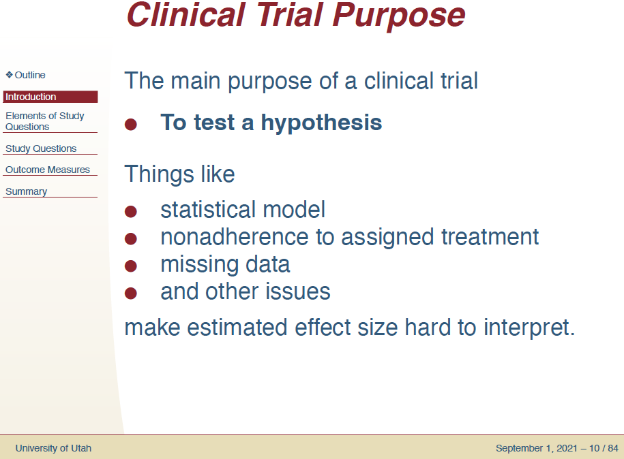
RCT’s test hypotheses about mean treatment effects
http://validtrials.info/sct2016/slides/
Charlie Casper PhD
Not to estimate effect sizes
FDA cares about hypotheses.
We care about individual patient
Treatment responses

Slide 7
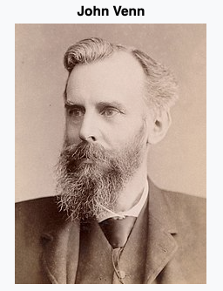

Yet, that’s not how we use trials
Average Treatment Effect → Individual Prediction about treatment response. How?
Venn: “It is obvious that every individual thing or event has an indefinite number of properties or attributes observable in it, and might therefore be considered as belonging to an indefinite number of different classes of things…”
How do we draw the line defining diseases? Infinite number of possibilities
How do we determine which patients are “like” the ones that benefited from ARMA and Wake Up & Breathe
Reference class problem: who is likely to benefit from the intervention of the trial?
The more precise the reference class, the lower the power for inference
Requires a theory to explain treatment responses to ’generalize’
Evidence-based medicine: Inclusion criteria = Defines reference class
Anyone who could be included in will, on average, be expected to benefit
“Model Free” assumption, but clearly not optimal. Inclusion criteria are (often) not based on pathophysiology (ARDS…),
yet a fundamental assumption of modern medicine is that pathophysiology that can be understand can be manipulated to our benefit.
we make hypotheses and inferences about what we think leads to the response based on physiology. Are these correct, and does decision-making based on this thinking improve outcomes? Hope so, but it’s almost always not demonstrable.
Notes:
BMJ article.
So back to our question: almost certaintly there are patients who will benefit or not benefit from LTVV and Wake-up-and breath - and if we draw the reference class around the trial inclusion criteria – more will be in the benefit group. BUT, it’s almost certaintly possible to do better – and to the extent that our pathophysiologic models are accurate this
Implication of this: we’ll never be able to predict individual patient responses at the level limited by reference group sample size without theories about what physiology drives the response. To get more granular – which we need to do, there’s still a need for the theory. And I think this is the best theory for this aspect.

Slide 8
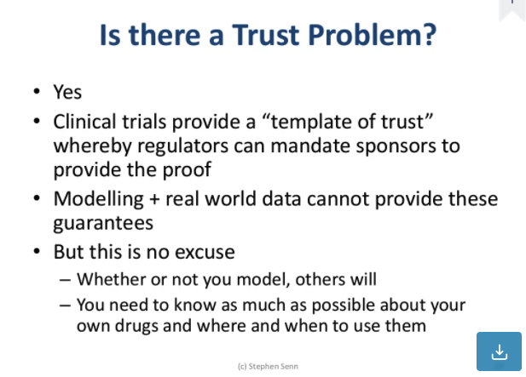
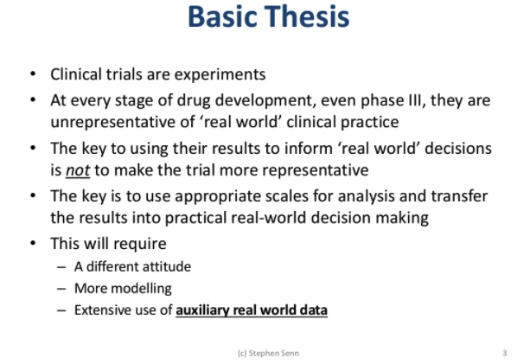
https://www.slideshare.net/StephenSenn1/real-world-modified

Slide 9
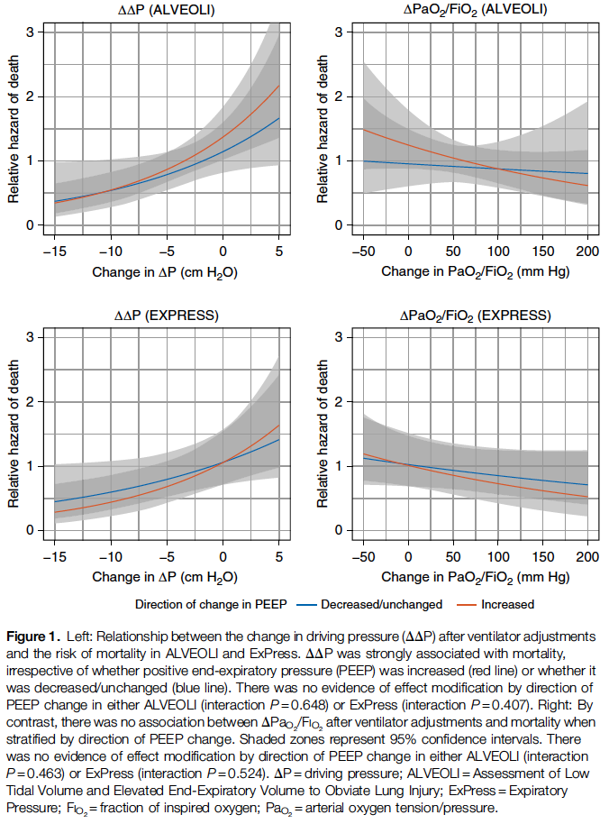
So what theory do we have?
Oxygen parameters continue to not exert much influence
Driving pressure seems to be related in non-proning ARDS adjustments: DOI: 10.1513/AnnalsATS.202007-862OC

Slide 10
[ ] https://link.springer.com/article/10.1007/s00134-020-06306-w: Review of this topic by Guerin, Albert, et al.
[ ] http://rc.rcjournal.com/content/62/8/1097.short review of gas exchange and proning.

